Slide 1
Thực hành ICT4 MIPSIT
Department of Computer Engineering

Slide 2
Instroduce to MIPSIT
MIPSIT: a tool to edit, compile and simulate programs based on Mips instruction set.
Literature: MIPS Lab Environment Reference
Download Home Assigment (week1-week6), + MIPSIT tool at:
http://dce.hut.edu.vn/daotao.htm#VIETNHAT

Slide 3
Installation
Extract MipsIt.rar to installed folder, “C:\MipsIt” for example. After this step, MipsIt folder will have following structure:
MipsIt\bin: include execution files, such as
MipsIt.exe: an editor and compiler program
Mips.exe: a simulator program
MipsPipeS.exe: a simple pipeline simulator program
MipsPipeXL.exe: a more complicated pipeline simulator program
…
MipsIt\include: include header files
MipsIt\lib: include library files
…

Slide 4
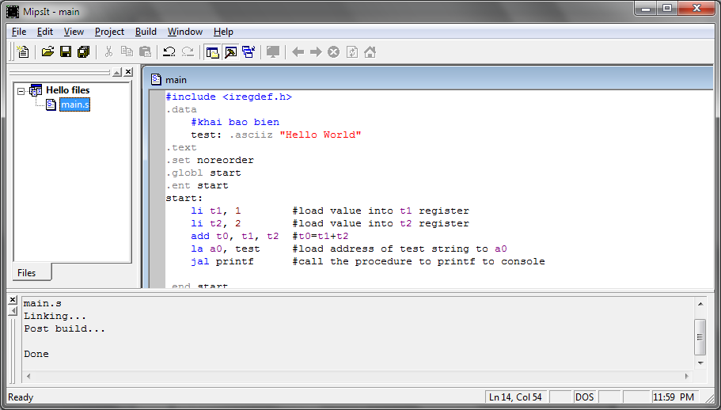
IDE Basics

Slide 5
IDE Basics
Files list
Editor
Compile, Build
Upload to Simulator

Slide 6
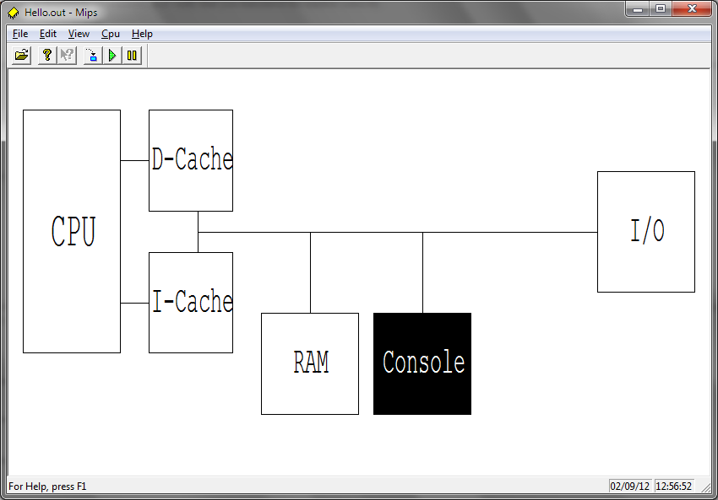
The Simulator
MIPS.exe

Slide 7
The Simulator
CPU View/modify the CPU registers. RAM View/modify memory, also referred to as the MemView. This unit has most functions of all, for a more detailed description see below. Console Standard input/output for programs that use it. I/O Simulates the 8-bit I/O unit, with 8 switches and 8 LEDs. D-Cache/I-Cache Views of the data and instruction caches. Interrupt Simulates the interrupt unit, with buttons K1, K2 and the timer.

Slide 8
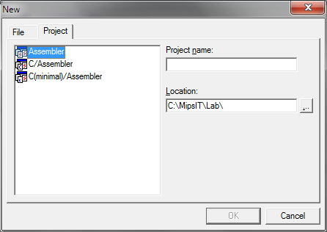
New project
Add files

Slide 9
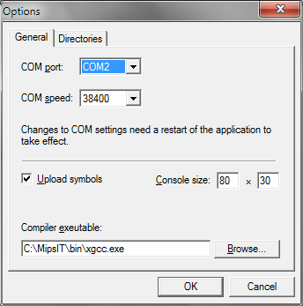
Chú ý: lỗi compile
Kiểm tra File/Option
Mục Compiler executable
Trỏ đến $Root\MipsIT\bin\xgcc.exe
(Không chứa dấu cách)

